Slide 1


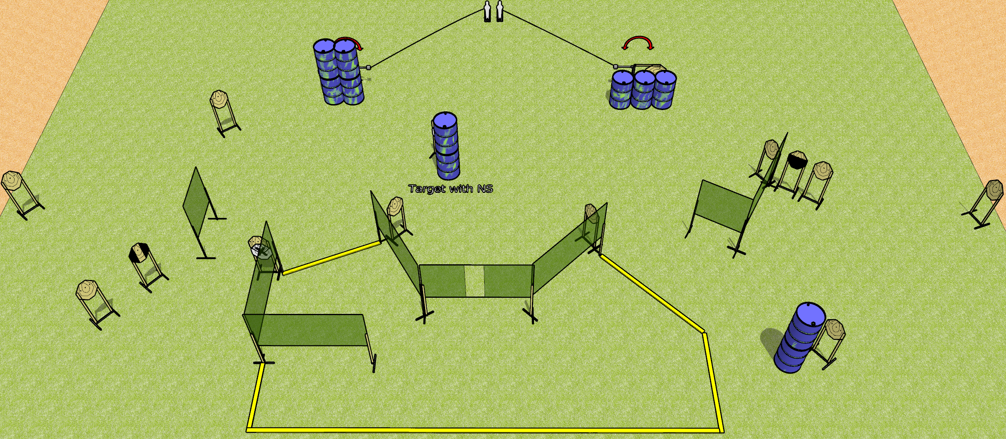
 | Dothan Gun Club – USPSA Match Full Send Course Designer : Drew Coleman
Round Count 30 rounds 14 ISPC 2 mini poppers
Equipment List 14 wall feet 2-3 medium wall feet Rear of shooting area should be 30’ across 1 tuxedo, 1 50%

Slide 2
Full Send
Written Stage Briefing
Full Send is a 30 round, 150 point, Comstock course of fire. There are 14 IPSC targets and 2 mini poppers. The best 2 hits on paper will score, and steel must fall to score. The start signal is audible.
The left swinger is activated by the left popper and the right swinger is activated by the right popper. Both swingers are visible at rest and must be activated before being engaged. Please check the activators prior to walkthrough and set them the same way every time.
Handgun start position is anywhere inside the shooting area, wrists below belt. Handgun is loaded and holstered.
PCC start position is anywhere inside the shooting area, stock on belt. Loaded carbine is held with both hands, safety on.
On start signal engage targets as they become available from within the shooting area.

